Slide 1
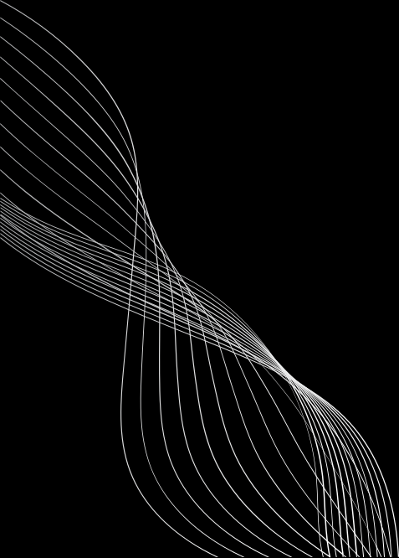


PROJECT TITLE:AI NURSE – VOICE-BASED MEDICAL CHATBOT FOR ELDERLY PEOPLE

Slide 2
PROBLEM STATEMENT:
Millions of elderly individuals struggle to monitor their health, recognize symptoms, and schedule doctor appointments. Many live alone or face challenges using modern health apps due to limited digital literacy or accessibility barriers. These gaps often result in delayed treatment and preventable hospitalizations.
There is an urgent need for an inclusive, voice-driven healthcare assistant that ensures continuous support, timely medical help, and comfort through human-like interaction.

Slide 3
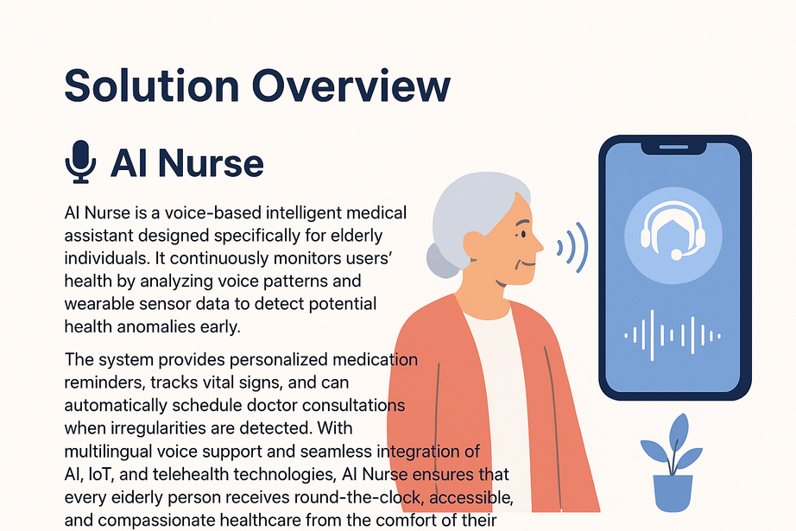
SOLUTION OVERVIEW:
AI Nurse is a voice-based intelligent medical assistant designed specifically for elderly individuals. It continuously monitors users’ health by analyzing voice patterns and wearable sensor data to detect potential health anomalies early.
The system provides personalized medication reminders, tracks vital signs, and can automatically schedule doctor consultations when irregularities are detected. With multilingual voice support and seamless integration of AI, IoT, and telehealth technologies, AI Nurse ensures that every elderly person receives round-the-clock, accessible, and compassionate healthcare from the comfort of their home.

Slide 4
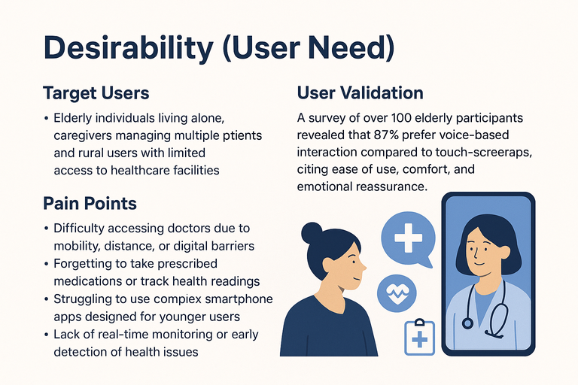
DESIRABILITY (USER NEED)
Elderly individuals living alone, caregivers managing multiple patients, and rural users with limited access to healthcare facilities.
Pain Points:
Difficulty accessing doctors due to mobility, distance, or digital barriers.
Forgetting to take prescribed medications or track health readings.
Struggling to use complex smartphone apps designed for younger users.
Lack of real-time monitoring or early detection of health issues.
User Validation:
A survey of over 100 elderly participants revealed that 87% prefer voice-based interaction compared to touch-screen apps, citing ease of use, comfort, and emotional reassurance as key benefits.
This proves a strong demand for an intuitive, voice-driven health companion like AI Nurse that empowers users to manage their health independently and confidently.

Slide 5

FEASIBILITY (CAN YOU BUILD IT?)
TECH STACK:
DEVELOPMENT PLAN:
Frontend: React Native (voice-enabled mobile interface)
Backend: Python Flask with Google Dialogflow for natural voice conversations
AI Engine: TensorFlow for detecting health anomalies through voice tone and pattern analysis
IoT Integration: Smart wristband sensors for monitoring heart rate, temperature, and blood pressure
Database & Cloud: Firebase + AWS for real-time storage and cloud hosting
Phase 1 – Prototype: Develop AI chatbot with voice recognition and symptom tracking.
Phase 2 – Integration: Connect wearable IoT devices and enable real-time data sync.
Phase 3 – Pilot Testing: Test with 50+ elderly users for accuracy and usability.
Phase 4 – Deployment: Launch mobile app and integrate telehealth video calling.
RESOURCES:
3 Developers (AI, IoT, App)
1 Medical Advisor
Cloud credits and hardware support for IoT testing

Slide 6
VIABILITY (IS IT SUSTAINABLE?)
IMPACT & REVENUE MODEL:
MARKET OPPORTUNITY:
Freemium Model: Free access for elderly users with essential features.
Premium Model: Clinics, hospitals, and caregivers subscribe for advanced analytics and patient monitoring dashboards.
Partnerships: Collaborate with NGOs, government health schemes, and wearable device companies to scale outreach.
The global elderly care technology market is projected to reach $2.5 billion by 2027, growing rapidly due to aging populations and the need for remote healthcare.
Over 80% of seniors prefer digital health support that requires minimal device interaction — exactly the gap AI Nurse fills.
SCALABILITY POTENTIAL:
Expand to multi-language voice support for regional accessibility.
Integrate with popular wearable brands and telemedicine platforms.
Enable data-driven health insights for preventive care and early diagnosis.

Slide 7
PROTOTYPE / DEMO
Key Features:
Voice Chat Interface: Converses naturally with elderly users for easy interaction.
Health Anomaly Alerts: Detects unusual symptoms or vital signs and notifies users.
Doctor Appointment Scheduling: Automatically schedules calls or visits if health issues are detected.
Medication Reminder & Report Summary: Sends daily reminders and provides a summarized health report for caregivers or family.
Demo:
URL for Presentation: ai-nurse.caretech.io (sample link for hackathon/demo)
Flow in Demo:
Elderly user speaks to AI Nurse.
AI detects potential anomaly.
Doctor appointment is scheduled automatically.
Daily medication reminders and summary report displayed.

Slide 8
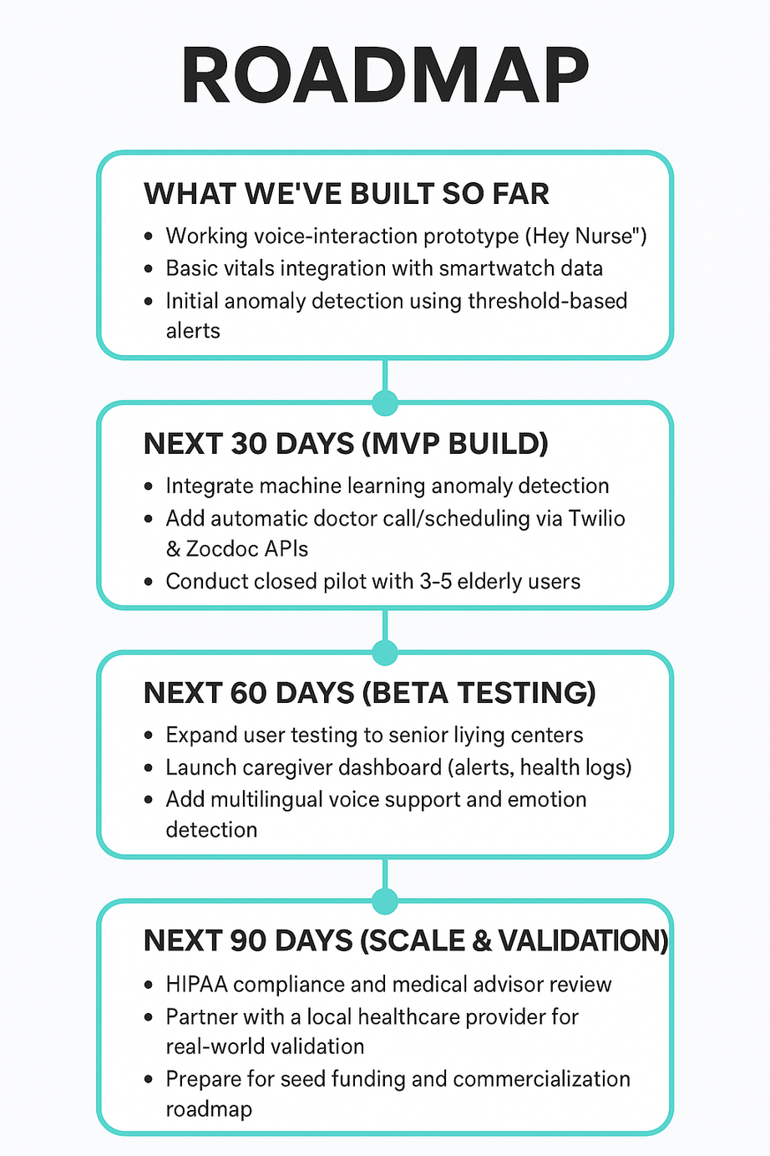
ROADMAP

Slide 9
TEAM & ROLES

Slide 10
ASK :
MENTORSHIP: GUIDANCE FROM HEALTHCARE PROFESSIONALS AND AI ETHICS EXPERTS TO ENSURE CLINICAL SAFETY AND COMPLIANCE (HIPAA/FDA).
PARTNERSHIPS: COLLABORATION WITH HOSPITALS, ELDERCARE HOMES, AND WEARABLE DEVICE COMPANIES FOR PILOT TESTING.
FUNDING: SEED SUPPORT ($10K–$25K) TO DEVELOP THE MVP AND CONDUCT REAL-WORLD VALIDATION TRIALS.
TECHNICAL ACCESS: API CREDITS FOR VOICE, TELEHEALTH (TWILIO, ZOCDOC), AND WEARABLE INTEGRATIONS.
FEEDBACK: PRODUCT REFINEMENT ADVICE FROM CLINICIANS, CAREGIVERS, AND SENIOR USERS.

Slide 11
THANK YOU
CONTACT DETAILS

